Slide 1

Home Credit Default Risk
Present to _VOIS - Technical Assessment
Made by: Ahmad Al-Hati

Slide 2
Content
Business case.
Business objective.
Pipeline.
Key insights.
Machine learning models.
Results & Conclusion.
References.
Github: https://github.com/AhmadAlhati/Kaggle-Home-Credit-Default-Risk.git

Slide 3
Business Case
“The only good loan is one that gets paid back.” — Robert Wilmers, chairman and CEO of M&T Bank
An existential problem for any Loan providers today is to find out the Loan applicants who are very likely to repay the loan. This way companies can avoid losses and incur huge profits.
Loans are also as important to Lenders as they are for Borrowers. Almost all Banking Organizations make most of their revenues from the interests generated through loans. However, the caveat here is that the lenders make a profit only if the loan gets repaid. The Lending Organizations are faced with the tough task of analyzing the risk associated with each client. Therefore, it is important to identify the risky behaviors of clients and make educated decisions.

Slide 4
Business Objective
Decision support process.
Increase borrower base.
Profit increase.
Revenue increase.
Decreasing exposure risk.

Slide 5
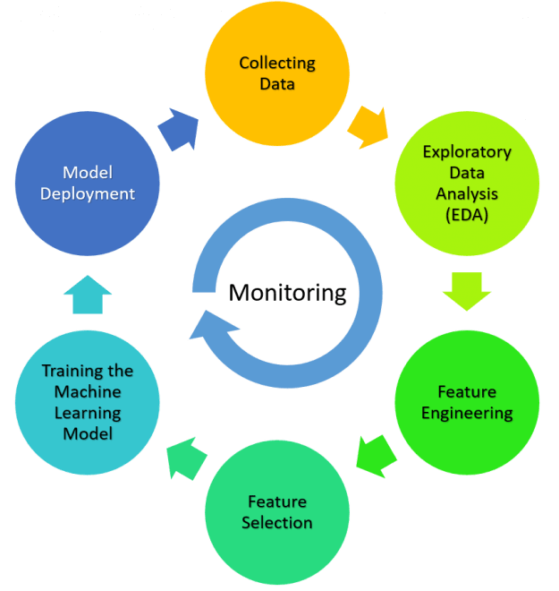
Pipeline

Slide 6
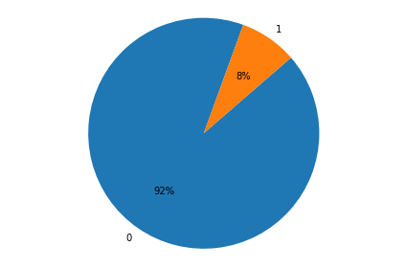
Key Insights
Target Count for training data
Unbalanced data issue
NOTE: All insights are available on notebook & analysis report.html

Slide 7
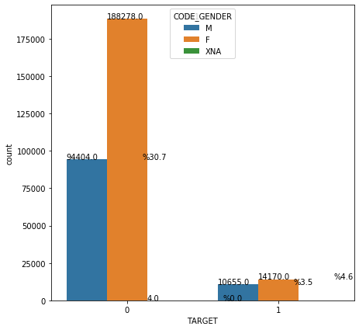
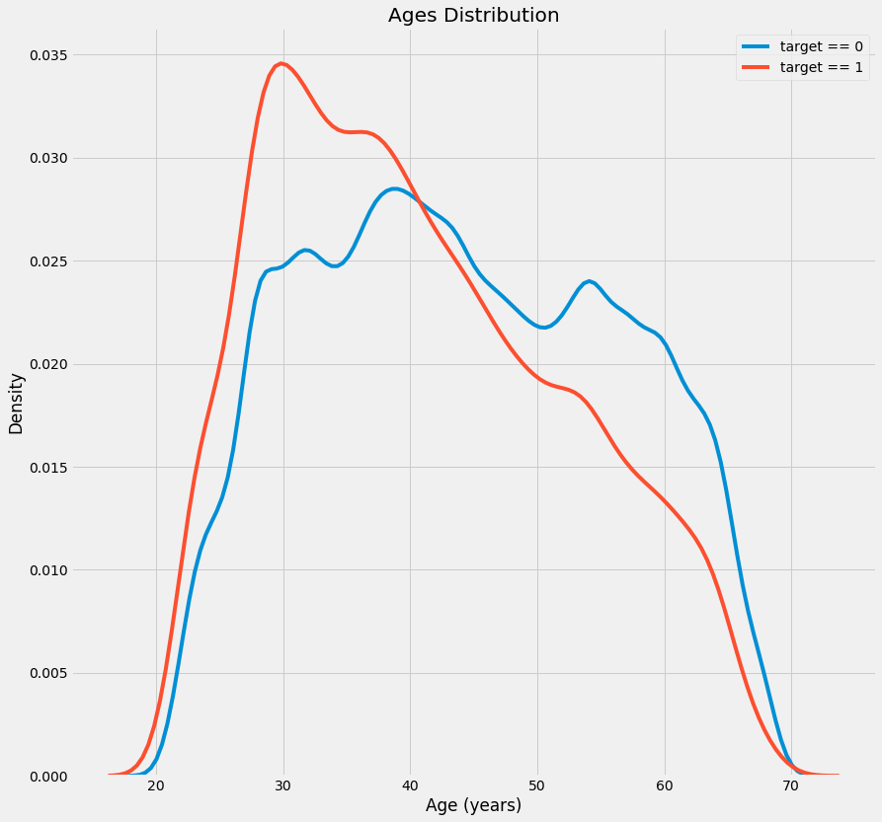
Age & Gender VS TARGET

Slide 8
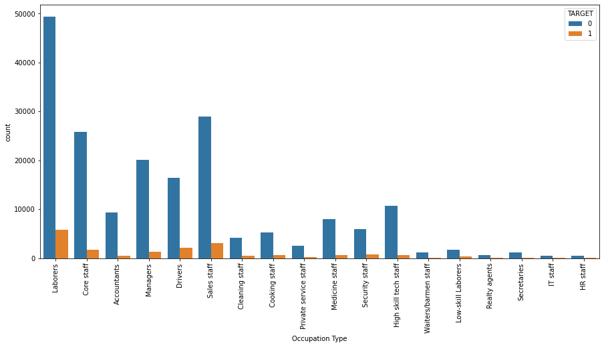

Slide 9
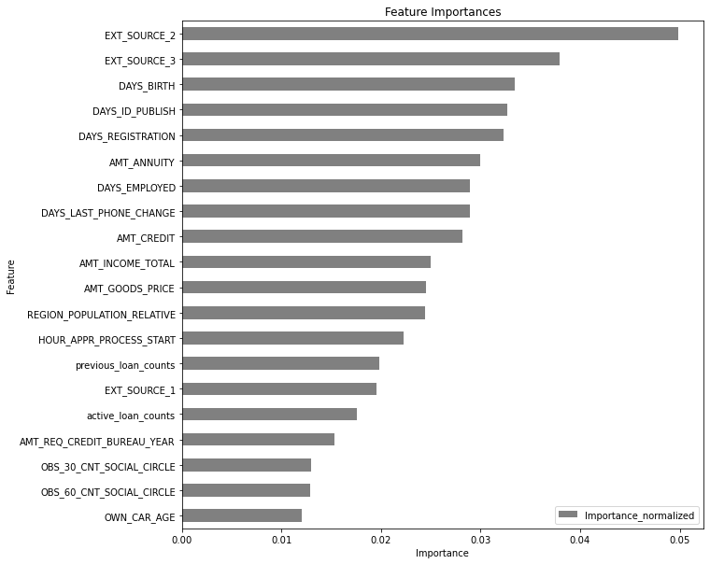
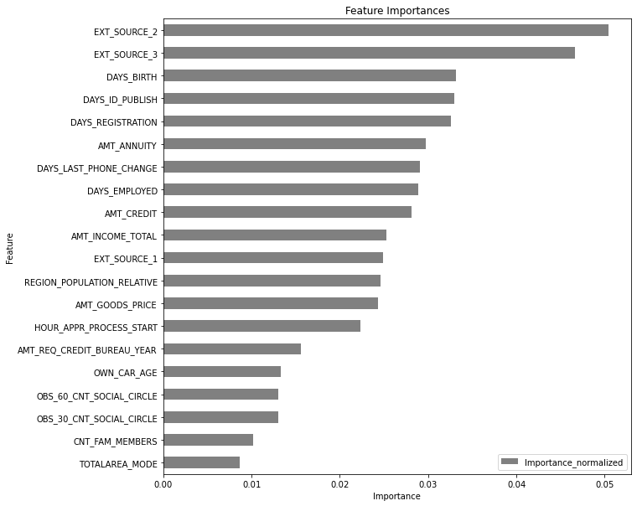
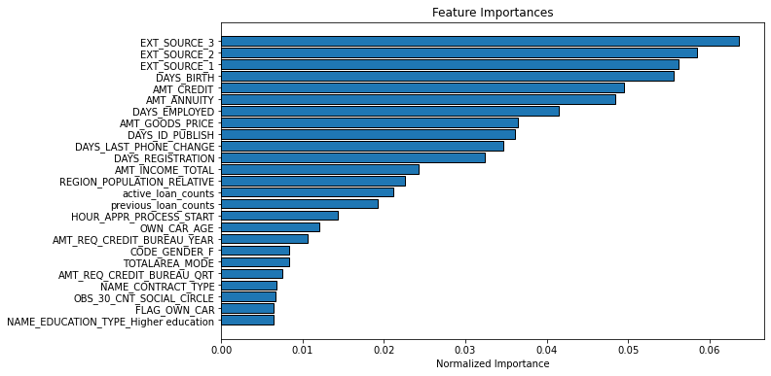
ML Models
LightGBM with Aggregated features
RF with row data

Slide 10
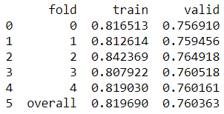
Results & Conclusions
Using AUC (Area under the ROC Curve) we achieved ~ 76% accuracy, which is not suitable for such a risky problem.

Slide 11
References
https://towardsdatascience.com/a-machine-learning-approach-to-credit-risk-assessment-ba8eda1cd11f
https://www.kaggle.com/willkoehrsen/start-here-a-gentle-introduction
https://medium.com/thecyphy/home-credit-default-risk-part-1-3bfe3c7ddd7a
https://becominghuman.ai/lightgbm-on-home-credit-default-risk-prediction-5b17e68a6e9

Slide 12
Thank You!
Github: https://github.com/AhmadAlhati/Kaggle-Home-Credit-Default-Risk.git

